Slide 1
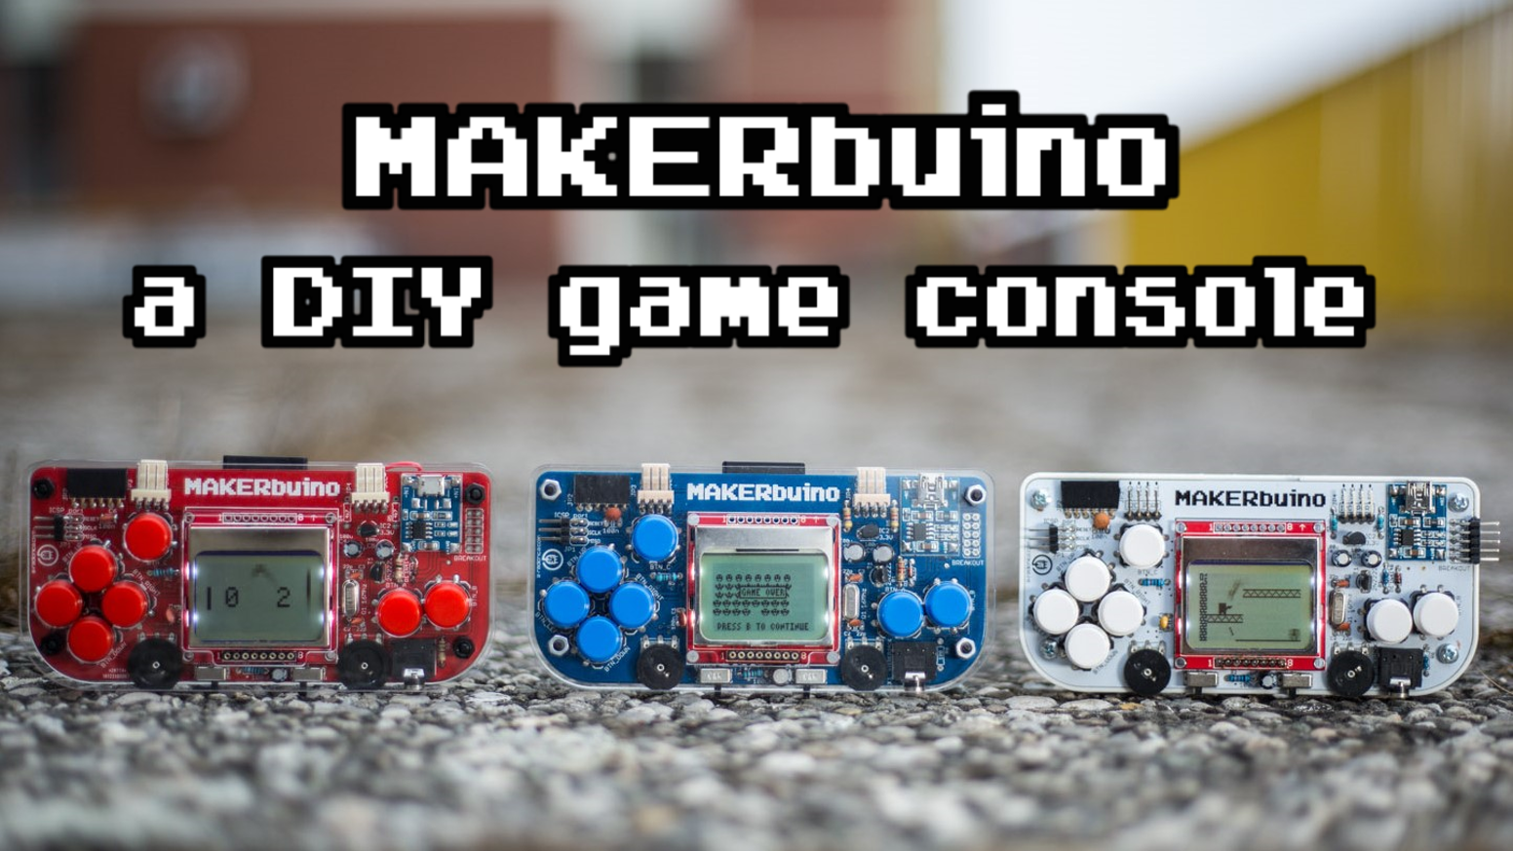
1

Slide 2
Table of contents
2
General presentation
Components
Button, sound and storage
12C protocol
Adapters and connectivity
Resistor, capacitors, quartz and micro controler
Step of the build
Community
My opinion

Slide 3
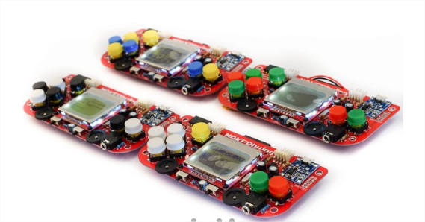
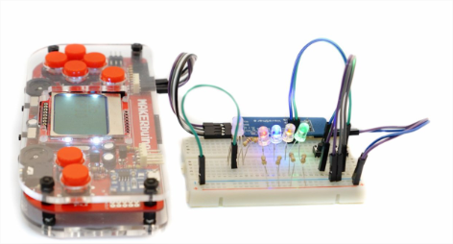
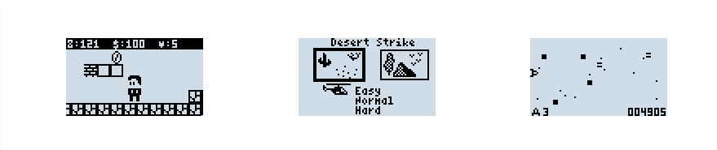
General presentation
3
Open source gameboy DIY (Do It Yourself)
Many video games
Build time : 5 – 6 h with soldering iron
Remote control
customization

Slide 4
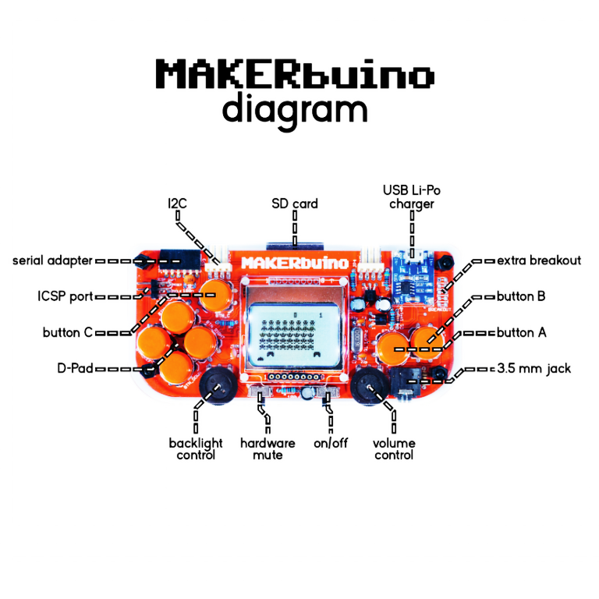
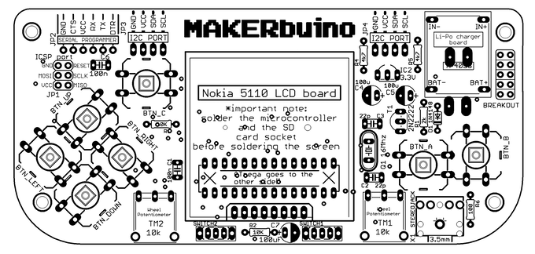
Buttons, sound and storage
4
Potentiomete
A B C up down right left
On/off
Mute
Jack
SD socket
SD card 128Mo

Slide 5
I2C protocol
5
SDA :
SCL :
GND:
VCC:

Slide 6
Adapters and connectivity
6
Usb adapter
ICSP port
Extra breakout
Serial adapter
screen

Slide 7
Resistor, capacitors, quartz and micro controler
7

Slide 8
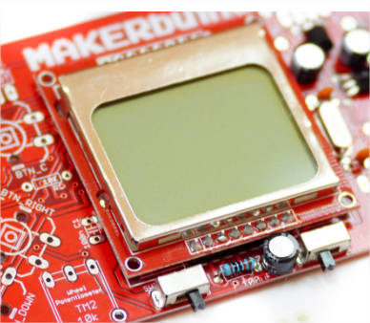
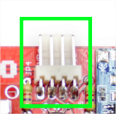
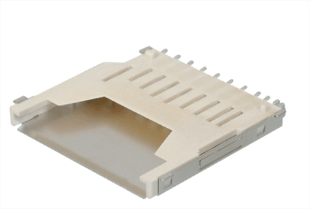
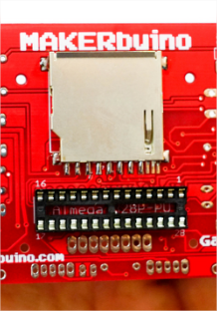
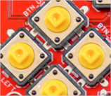
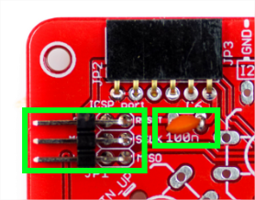
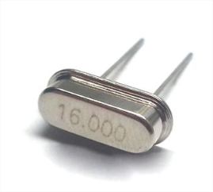
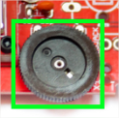


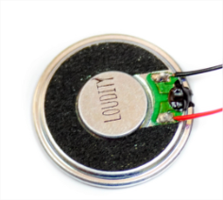

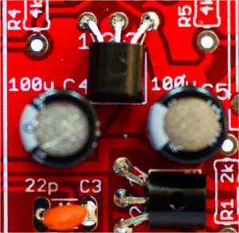
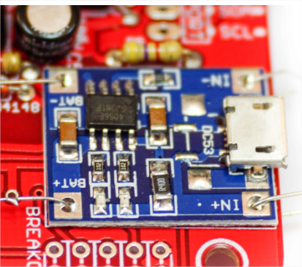
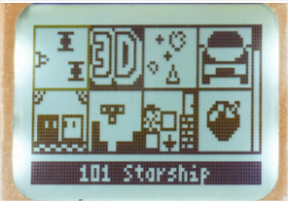
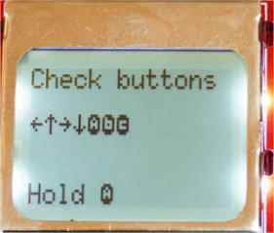
Step of the built
8
5 – screen
9 – multiplayer headers
1 – SD socket
6– headers, others resistor / capacitors and potentiometers
2 – Microcomputer socket’s
10– pushbuttons
3 – some resistor, quartz, buttons
11– speacker
7 –headphone connector
4 – transistor and capacitors
12– set up and have fun !
8 –charger
board

Slide 9

Community
9

Slide 10
My opinion
10

